Slide 1
How to Create a Wikipedia Account
www.aflia.net

Slide 2
1. Visit Wikipedia: https://www.wikipedia.org/ and select language of choice

Slide 3
2. Click the "Sign in/create account" link in the upper right corner on the Wikipedia website.

Slide 4
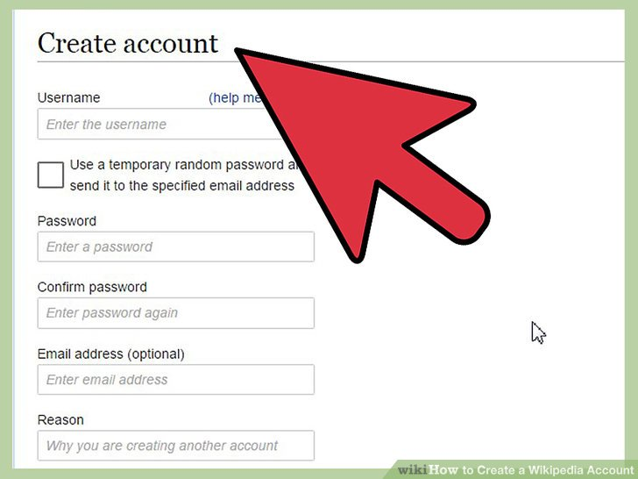
3. Click the link "Create One" above the boxes. This will take you to the account creation page.

Slide 5
4. Type the captcha. Wikipedia now presents people with a simple captcha to solve to prevent against computer activated programs signing up. Type it in the box below (refresh the image if you must) and move on to the next step.

Slide 6
Step 5
Enter your desired user name in the "Username:" box. This will be the name of your account. For suggestions for usernames, see below.
Scramble your real name. No one will know. Make it an anagram, meaning that they are words that can be rearranged to form, in this case, your real name.
Look to social media. If you have a social media account, you can use the same username as your social media username (if it is not taken), but you may not want to do so if you are a famous user.
Think creatively. Have any passions, including computers, languages, companies, etc.? Choose a username suitable for your interests.
Don't choose a username that promotes another business, flags you as a vandal, impersonates an admin, or is just plain annoying. Those get blocked quickly.

Slide 7
Step 5: Enter your desired user name in the "Username:" box

Slide 8
6. Enter a password in the "Password:" box. Make sure that you can remember your password, but for it to be hard for anyone else to guess.

Slide 9
7. Re-enter the same password as above in the "Confirm Password:" box.

Slide 10
8. Enter your e-mail address in the "E-mail" box if you want to. For more information about this, see below in the "Tips" section.

Slide 11
9. Click the big "Create account" button.

Slide 12
10. Congratulations! You are now a registered user in Wikipedia!

Slide 13
Additional Useful Links:
1. https://www.webmafias.com/create-a-wikipedia-account/
2. https://www.youtube.com/watch?v=nq0heoghu5E
3. https://www.youtube.com/watch?v=MVU1FyCrsSI
4. https://www.youtube.com/watch?v=4quCf3ygYac&t=8s

